Slide 1
How to use the search bar and filters

Slide 2
Index
Log into your account
Use the search bar
Using search filters
Using the “Publisher” search filter
Reset filters after every search
Using the “Types of content” search filter
Using the “Subscription” search filter
Using the “More filters” search filter
Click “Update”
The results

Slide 3
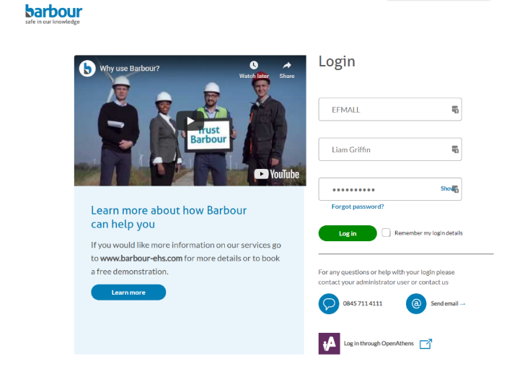
Log into your account
Login into your account through our homepage.

Slide 4
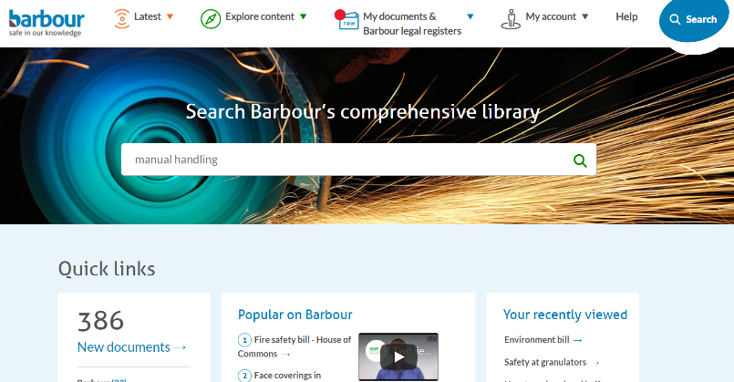
Use the search bar
You can begin by typing the topic you require information on in the ‘search bar’.

Slide 5
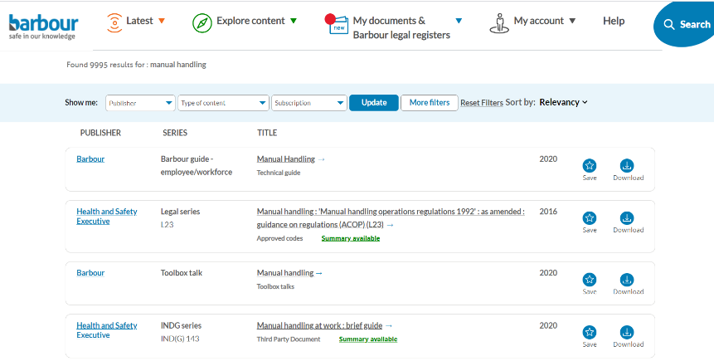
Using the search filters
The search results page will return all results that match your search query. Using the filters at the top of the page will help you narrow down your search.

Slide 6
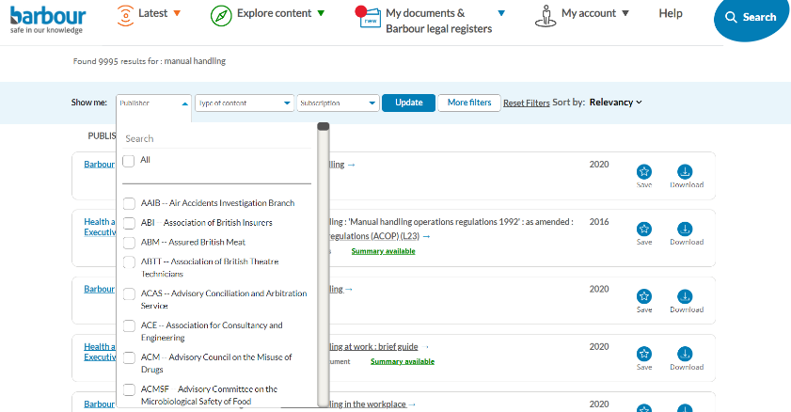
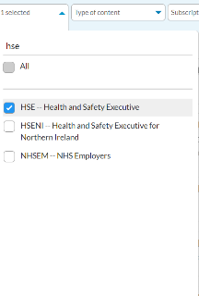
Using the “Publisher” search filter
You can refine your search by selecting a ‘Publisher’. You can either scroll through our list of publishers and select them or type in the name of the publisher in the search bar.

Slide 7
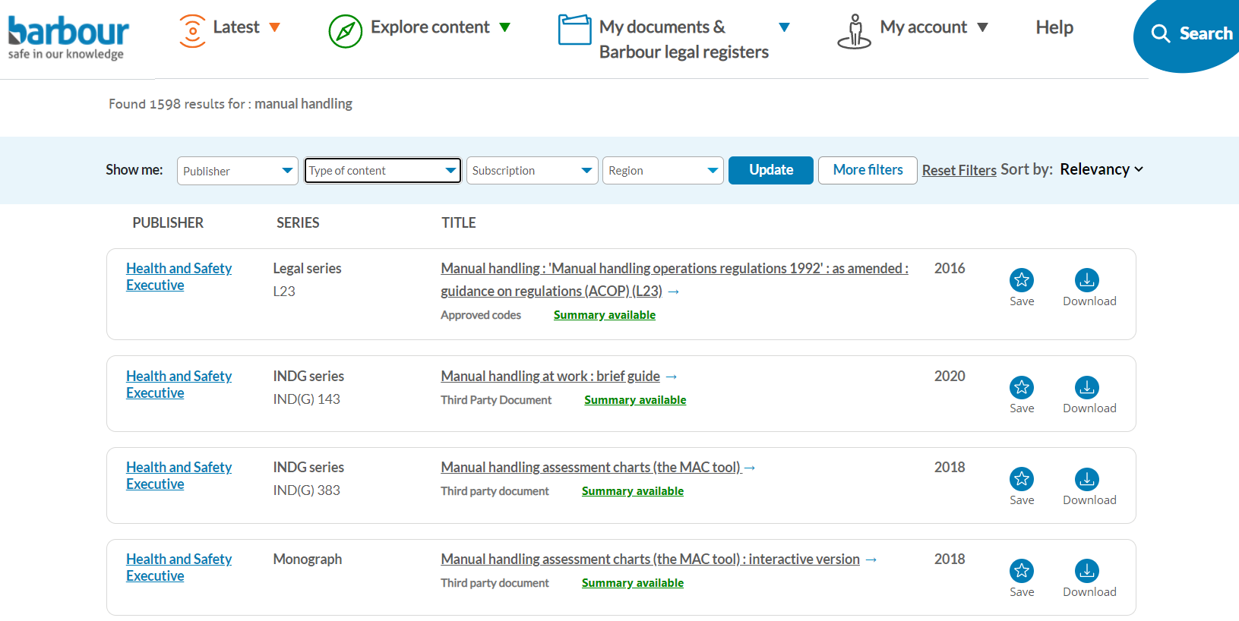
Reset filters after every search
If you want to change filters, you first need to clear your existing filter and reset the filters by clicking ‘Reset filters’ and then click ‘Update’.

Slide 8
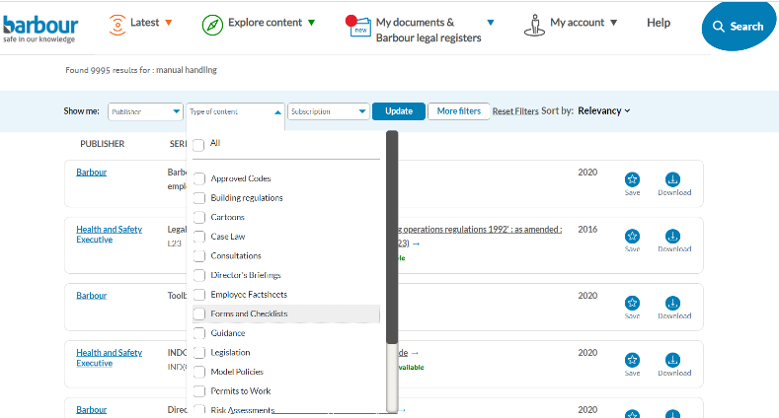
Using the “Types of content” search filter
You can refine your search by selecting a ‘Type of content’. You can scroll through our list of content types and select the document you wish to use.

Slide 9
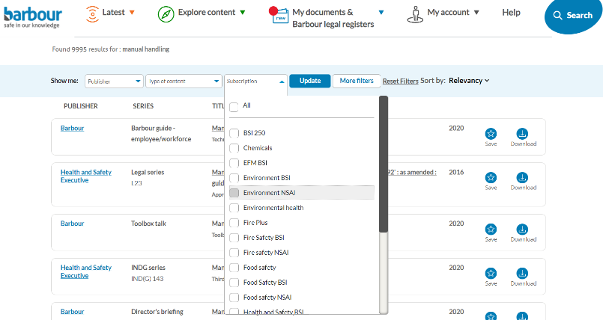
Using the “Subscription” search filter
You can refine your search by selecting a ‘Subscription’. The options in the subscription filter will reflect the modules you have access to.

Slide 10
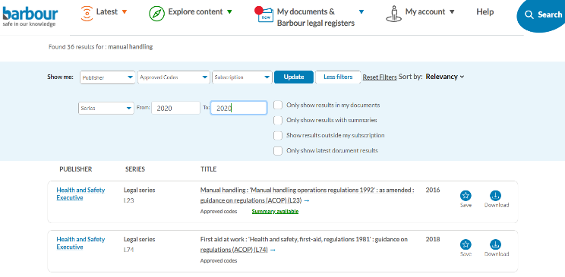
Using the “More filters” search filter
You can click ‘More filters’ to find more search filters. You can enter the current year to find only the most up to date documents.

Slide 11
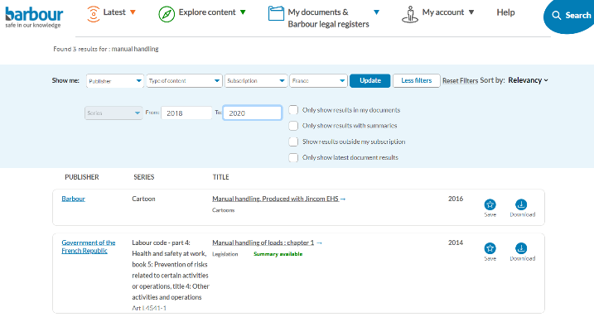
Using the “More filters” search filter
If you only want results in your documents, summaries, results outside your subscription or the latest document, you can select this on the right.

Slide 12
Click “Update”
It’s important that every time you change a filter you click ‘Update’ so the results reflect your filter updates.

Slide 13
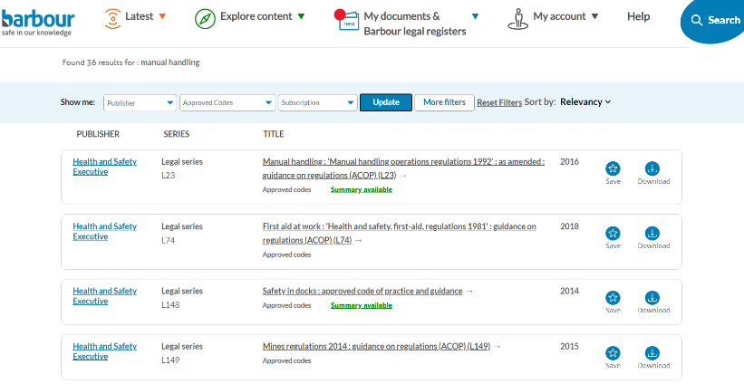
The results
Your search results will show results that fit the conditions you set in the search filters.

Slide 14
Thank you
If you still require assistance you can contact us: Help-barbour@informa.com
0845 711 4111

