Slide 1
How to use the
Explore Content tab
in Barbour

Slide 2
Index
Log into your account
Homepage
Explore content
Topics
Explore topics
Topic overview
Available resources
Types of content
Publishers

Slide 3
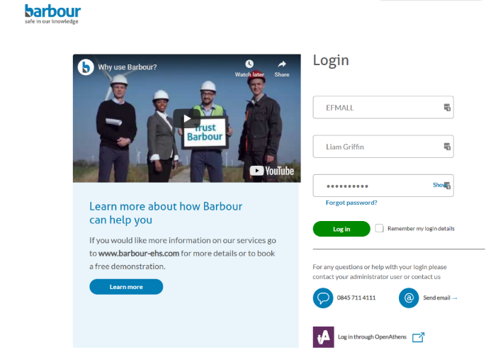
Log into your account
Login into your account through our homepage.

Slide 4
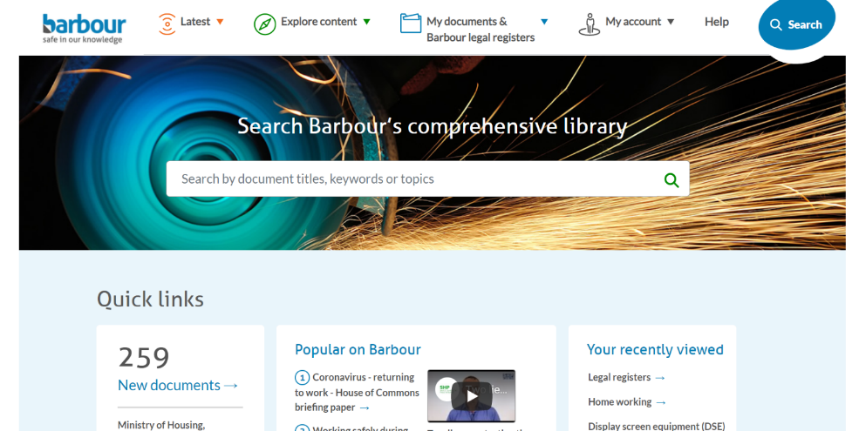
Homepage

Slide 5
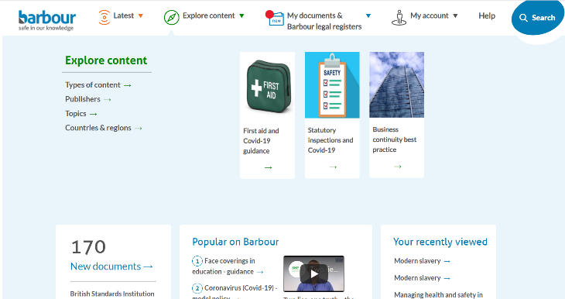
Explore content
The ‘Explore Content’ section contains all the information within the Barbour library that we have grouped together under individual topics so you have quick access.

Slide 6
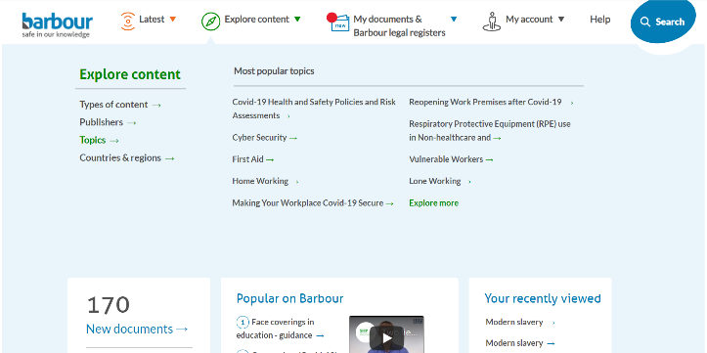
Explore content - Topics
You can search the library by topics. By hovering over ‘Topics’, the most popular subjects people are looking at will be displayed but you can ‘Explore more’.

Slide 7
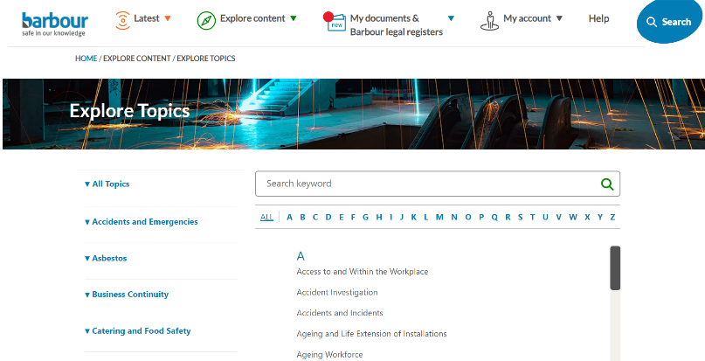
Explore content – Explore topics
This gives you a full A-Z of all the topics that we cover. You can use this feature in one of three ways.

Slide 8
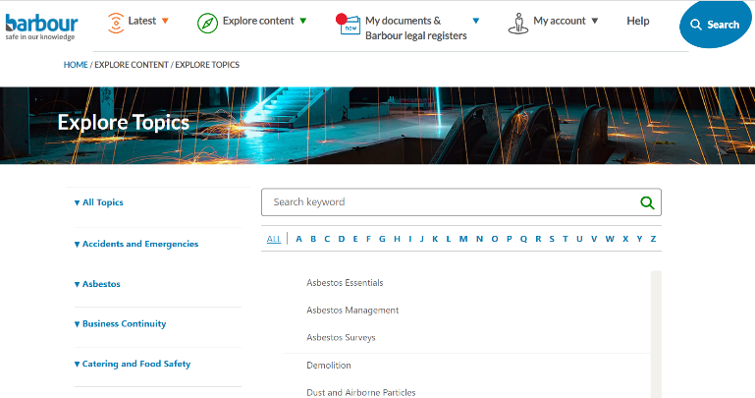
Explore content – Explore topics
You can use click on the menu on the left hand side of your screen, which lists topic titles. Doing this will display the subtitles within this topic area.

Slide 9
Explore content – Explore topics
You can select a letter at the top of the page to narrow down your topic search. Ensure you have selected ‘All Topics’ otherwise this will not work.

Slide 10
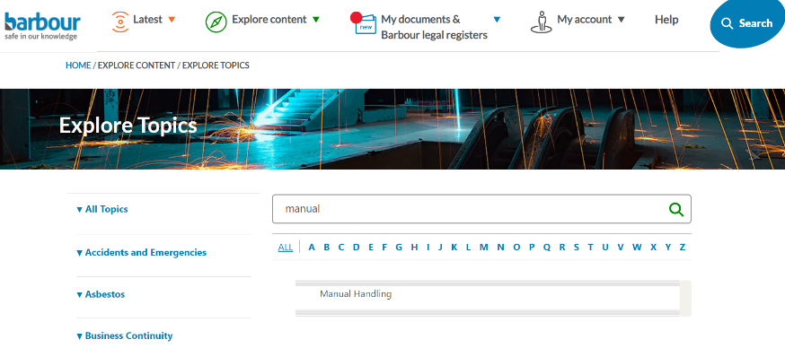
Explore content – Explore topics
Finally, you can use the search bar at the top of the page to search for the topic of your interest.

Slide 11
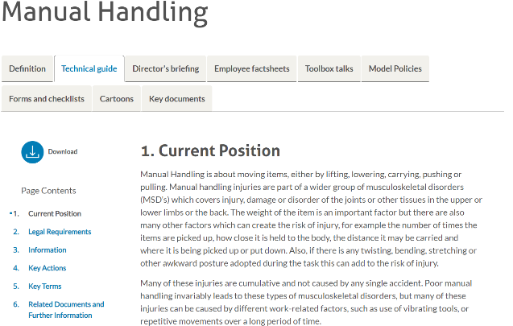
Explore content – Topic Overview
Once you have found your chosen topic, click it and you will be redirected to the topic overview. Here you will find a summary of the topic along with other resources you can use.

Slide 12
Explore content – Available resources
Some of the resources available to you are ‘Directors Briefings’, which are short handouts to help senior managers or above. ‘Employee Factsheets’, which are short handouts explaining to an employee their responsibilities. ‘Toolbox talks’ are PowerPoint presentations to enable you to create training sessions.

Slide 13
Explore content – Available resources
‘Model Policies’ are templates for you to use to create a policy or update your own. ‘Forms and Checklists’ can be used to update your own or create new checklists. ‘Cartoons’ are short handouts on main safety issues which can be used as an alternative way of learning.

Slide 14
Explore content – Available resources
‘Key documents’ cover all the documents the editors have read to write the Barbour resources on this topic.

Slide 15
Explore content – Types of content
You can search the library by ‘Types of content’. This gives you a full A-Z list of types of content within the Barbour library. To see them all click on ‘Explore more’.

Slide 16
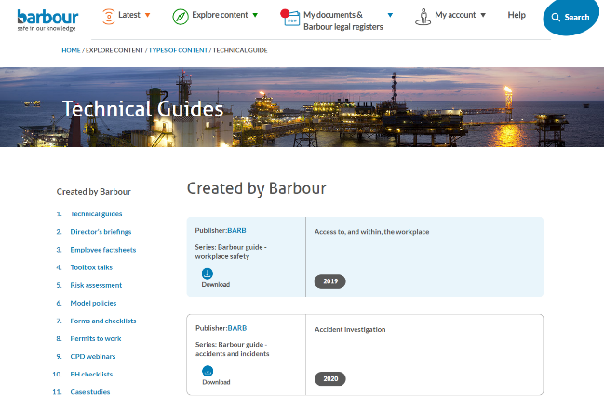
Explore content – Types of content
By selecting ‘Technical Guides’ you will be redirected to an A-Z list within the Barbour library. If you wish to view another content type, you can use the quick menu on the left.

Slide 17
Explore content – Publishers
You can search the library by ‘Publishers’. You will initially see the most popular publisher on the Barbour site but can click ‘Explore more’ to see the full list.

Slide 18
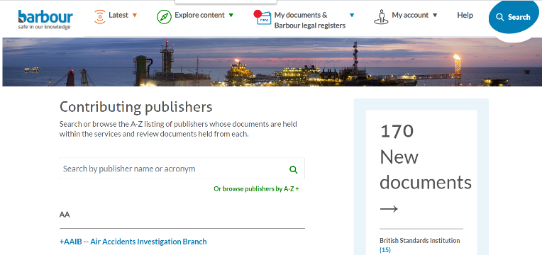
Explore content – Publishers
You can use the search bar at the top to look for your publisher of choice, or scroll through the page.

Slide 19
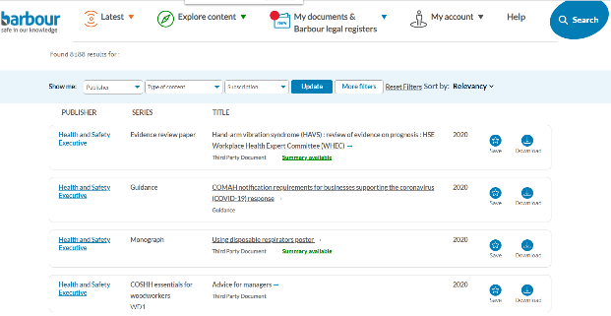
Explore content – Publishers
Once you have found your chosen publisher, you will see their contact details and by clicking ‘See document’ you can view all of the documents within our library produced by that publisher. This total number can be seen at the top of the page.

Slide 20
Thank you
If you would like any further assistance, please get in touch:
help@barbour-ehs.com
0845 711 4111

