Slide 1
How to use the
latest tab

Slide 2
Index
Log into your account
Homepage
Latest
Industry news
Latest documents
Legislation diary

Slide 3
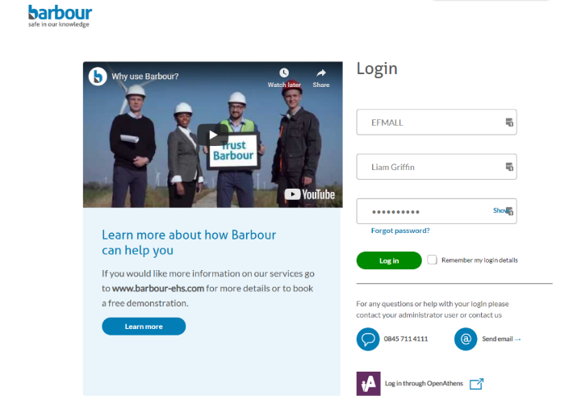
Log into your account
Login into your account through our homepage.

Slide 4
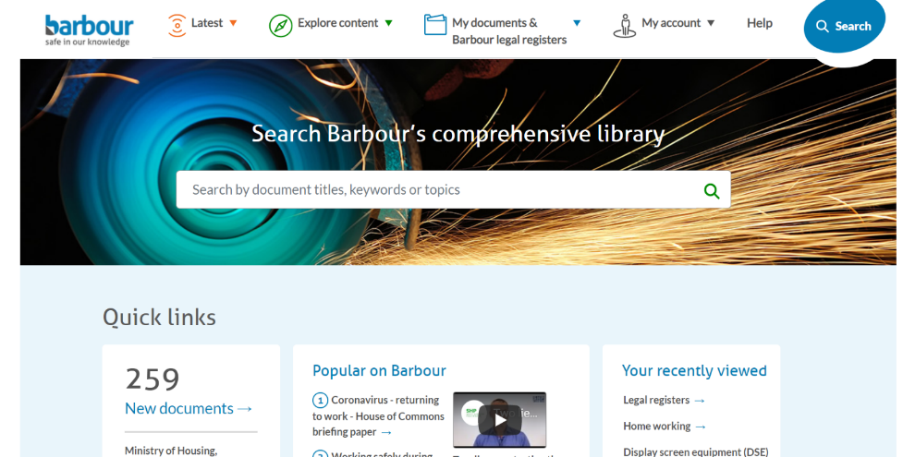
Homepage

Slide 5
Latest
The ‘Latest’ section contains the very latest news, documents and our legislation diary for upcoming legislation and consultations.

Slide 6
Industry news

Slide 7
Industry news
The ‘Industry news’ section offers you a weekly update of all the news, prosecutions and everything else that is happening within health and safety and other topics.

Slide 8
Industry news
This section is broken down into different topics so you can navigate to what is relevant to you.
Each topic is broken down even further into news, guidance, legislation and more.

Slide 9
Industry news
If you wanted to search for a particular topic by keyword, you can use the search bar at the top of the page.
When you press enter, your search results will be displayed where you can filter by ‘Type of news’ or by ‘Subscription’.

Slide 10
Industry news
You can also change the date of the week if you missed out on important news by selecting ‘Change date’.
This ‘Industry news’, goes back 3 months in case you missed out on something recently.

Slide 11
Industry news
Every section contains a list of all the articles and links to that article. So to save you time, simply click the article you are interested in and you will be taken there.

Slide 12
Latest documents

Slide 13
Latest documents
Within the ‘Latest documents’ section, you can search for the latest legislation, guidance and other content that has been added to the Barbour service.

Slide 14
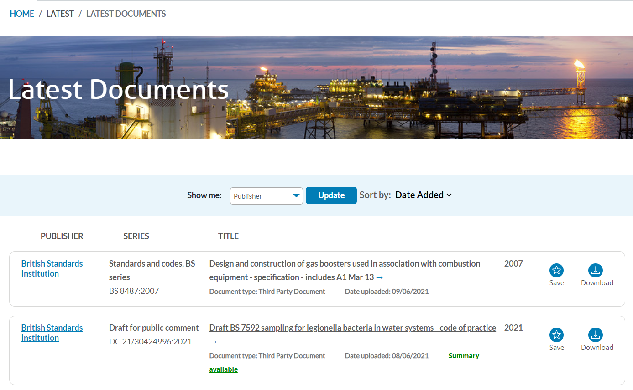
Latest documents
You can search for your favourite publisher using the filter at the top of the page. Once you have selected your favourite publisher, click ‘Update’.

Slide 15
Latest documents
The results will show all of the latest documents from your preferred publisher that have been added to our service.

Slide 16
Legislation diary

Slide 17
Legislation diary
Within the ‘Legislation diary’ section, you will be informed with what legislation will come into affect and when, so you are prepared for what is coming ahead.

Slide 18
Legislation diary
Our ‘Legislation diary’ goes back 6 weeks but goes forward up to 2022.
This is a great way to horizon scan into the future and ensure you are prepared for what is coming.

Slide 19
Legislation diary
You can search for legislation by ‘Publisher’. In this example I have used ‘Parliament’.

Slide 20
Legislation diary
The results will return all the legislation that is either in progress or upcoming from ‘Parliament’.

Slide 21
Legislation diary
You can also choose to filter by date using the option at the top of the page. This allows you to select when legislation will come into force at a particular time frame.

Slide 22
Legislation diary
This will change the ‘Comes into force’ date that has been highlighted in the image of the right. This will allow to prepare for upcoming legislation between a specific time frame.

Slide 23
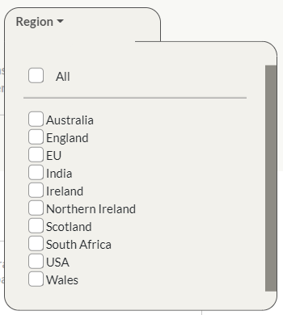
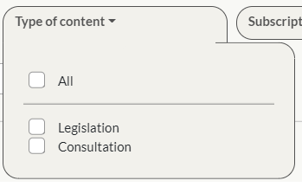
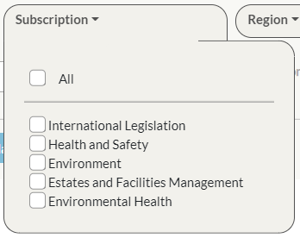
Legislation diary
We also have other filter options that can make finding legislation easier for you. You can filter by ‘Type of content’, ‘Subscription’ or ‘Region’.

Slide 24
Thank you
If you would like any further assistance, please get in touch:
help@barbour-ehs.com
0845 711 4111

